Slide 1
PROBABILITY
Here is where your presentation begins

Slide 2

Created By
Guided by Prof. Tejal Nagar

Slide 3
TABLE OF CONTENT
Introduction to probability
Basic Probability Concepts
Probability Rules
Probability Distribution
Conditional Probability
Bayes’ Theorem
Expected Value
Variance and Standard Deviation
Probability Models
Law of Large Number
Central Limit Theorem

Slide 4
Introduction To Probability
01

Slide 5
INTRODUCTION
Mathematics and statistics consider probability a fundamental concept that measures the chance of an event happening.
This is an essential idea in finance, science and engineering as it assists in decision making, risk assessment and outcome prediction.
The knowledge of probability helps us in weighing different alternatives for appropriate actions.
During this talk, we will look at various aspects of probability including its basics, uses and how it can assist us in uncertainty assessment and decision-making that is more effective.

Slide 6
Basic Probability Concept
02

Slide 7
BASIC PROBABLITY CONCEPT
Basic Definitions:
Experiment: The process that produces outcomes.
Sample Space (S): The set of all possible outcomes of an experiment.
Event: A subset of the sample space.
Probability (P): A numerical measure of the likelihood of an event occurring, ranging from 0 (impossible) to 1 (certain).
Types of Probability:
Classical Probability: Based on equally likely outcomes.
Empirical Probability: Based on observed data.
Subjective Probability: Based on personal judgment or experience.

Slide 8
03
Probability Rules

Slide 9

Rules of Probability:
Addition Rule:
P(A or B) = P(A) + P(B) - P(A and B)
Multiplication Rule:
P(A and B) = P(A) * P(B|A)
Complement Rule:
P(not A) = 1 - P(A)

Slide 10
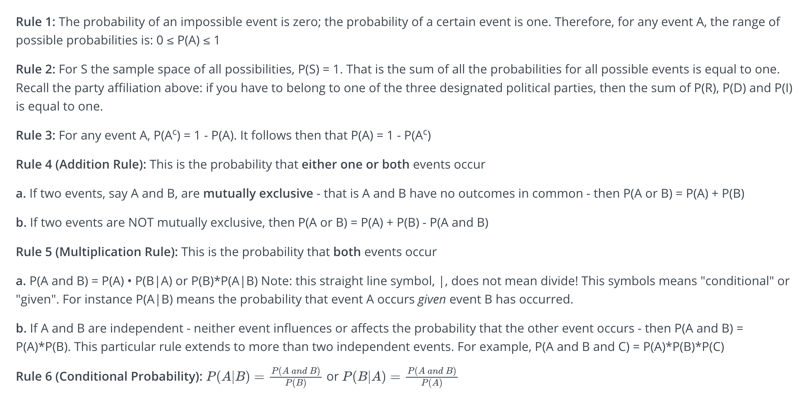

Slide 11
Probability Distributions
04

Slide 12
RULES OF PROBABILITY
1) Possible values for probabilities range from 0 to 1
0 = impossible event 1 = certain event
2) The sum of all the probabilities for all possible outcomes is equal to 1.
Note the connection to the complement rule.
3) Addition Rule - the probability that one or both events occur
mutually exclusive events: P(A or B) = P(A) + P(B) not mutually exclusive events: P(A or B) = P(A) + P(B) - P(A and B)
4) Multiplication Rule - the probability that both events occur together
independent events: P(A and B) = P(A) * P(B) P(A and B) = P(A) * P(B|A)
5) Conditional Probability - the probability of an event happening given that another event has already happened
P(A|B) = P(A and B) / P(B)

Slide 13
Conditional Probability
O5

Slide 14
PROBABILITY DISTRIBUTION
Types of Probability Distribution
The probability distribution is divided into two parts:
Discrete Probability Distributions
Continuous Probability Distributions
Discrete Probability Distribution
A discrete distribution describes the probability of occurrence of each value of a discrete random variable.
The number of spoiled apples out of 6 in your refrigerator can be an example of a discrete probability distribution.
Each possible value of the discrete random variable can be associated with a non-zero probability in a discrete probability distribution.

Slide 15
Binomial Distribution
The binomial distribution is a discrete distribution with a finite number of possibilities. When observing a series of what are known as Bernoulli trials, the binomial distribution emerges.
A Bernoulli trial is a scientific experiment with only two outcomes: success or failure.
Consider a random experiment in which you toss a biased coin six times with a 0.4 chance of getting head.
If 'getting a head' is considered a ‘success’, the binomial distribution will show the probability of r successes for each value of r.
The binomial random variable represents the number of successes (r) in n consecutive independent Bernoulli trials.

Slide 16
CONDITIONAL PROBABILITY
Conditional probability is known as the possibility of an event or outcome happening, based on the existence of a previous event or outcome. It is calculated by multiplying the probability of the preceding event by the renewed probability of the succeeding, or conditional, event.
Formula of Conditional Probability:
P(A|B) = N(A∩B)/N(B)
Or
P(B|A) = N(A∩B)/N(A)

Slide 17
06
Bayes’ Theorem

Slide 18


BAYES’ THEOREM
Bayes Theorem Statement
Let E₁, E₂,…, E_{n} be a set of events associated with a sample space S, where all the events E₁, E₂,…, E_{n} have nonzero probability of occurrence and they form a partition of S. Let A be any event associated with S, then according to Bayes theorem,
Bayes Theorem Formula
If A and B are two events, then the formula for the Bayes theorem is given by:
Where P(A|B) is the probability of condition when event A is occurring while event B has already occurred.

Slide 19
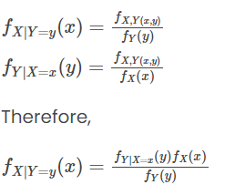
Bayes Theorem Derivation
Bayes Theorem can be derived for events and randoms variables separately using the definition of conditional probability and density.
From the definition of conditional probability, Bayes theorem can be derived for events as given below:
P(A|B) = P(A ⋂ B)/ P(B), where P(B) ≠ 0
P(B|A) = P(B ⋂ A)/ P(A), where P(A) ≠ 0
Here, the joint probability P(A ⋂ B) of both events A and B being true such that,
P(B ⋂ A) = P(A ⋂ B)
P(A ⋂ B) = P(A | B) P(B) = P(B | A) P(A)
P(A|B) = [P(B|A) P(A)]/ P(B), where P(B) ≠ 0
Similarly, from the definition of conditional density, Bayes theorem can be derived for two continuous random variables namely X and Y as given below:

Slide 20
07
Expected Value

Slide 21
EXPECTED VALUE
To calculate the EV for a single discrete random variable, you must multiply the value of the variable by the probability of that value occurring.
Take, for example, a normal six-sided die. Once you roll the die, it has an equal one-sixth chance of landing on one, two, three, four, five, or six. Given this information, the calculation is straightforward:

Slide 22
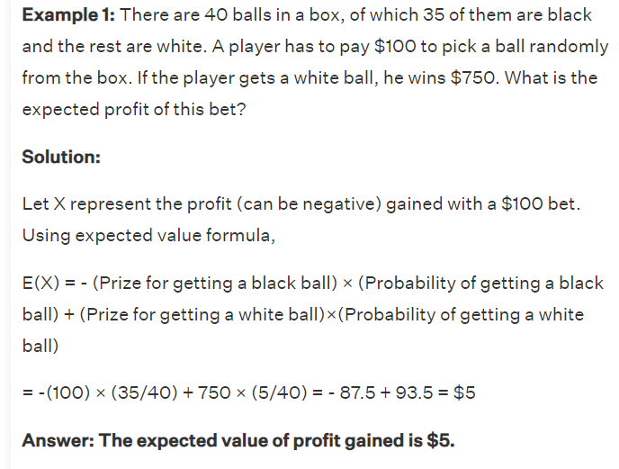

Slide 23
Variance & Standard deviation
08

Slide 24
VARIAANCE AND STANDARD DEVIATION
VARIAANCE:
Variance is a measure of how data points vary from the mean, whereas standard deviation is the measure of the distribution of statistical data. The basic difference between both is standard deviation is represented in the same units as the mean of data, while the variance is represented in squared units.
Properties of Variance
It is always non-negative since each term in the variance sum is squared and therefore the result is either positive or zero.
Variance always has squared units. For example, the variance of a set of weights estimated in kilograms will be given in kg squared. Since the population variance is squared, we cannot compare it directly with the mean or the data themselves.

Slide 25
Standard Deviation:
The spread of statistical data is measured by the standard deviation. Distribution measures the deviation of data from its mean or average position. The degree of dispersion is computed by the method of estimating the deviation of data points. It is denoted by the symbol, ‘σ’.
Properties of Standard Deviation
It describes the square root of the mean of the squares of all values in a data set and is also called the root-mean-square deviation.
The smallest value of the standard deviation is 0 since it cannot be negative.
When the data values of a group are similar, then the standard deviation will be very low or close to zero. But when the data values vary with each other, then the standard variation is high or far from zero.

Slide 26
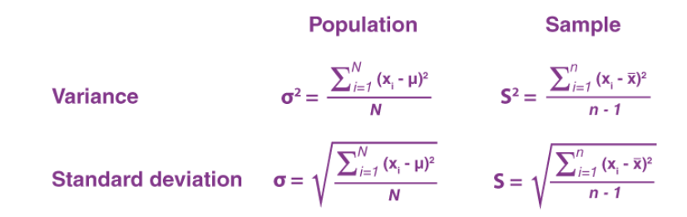
Formula of Variance and Standard deviation:

Slide 27
09
Probability Models

Slide 28
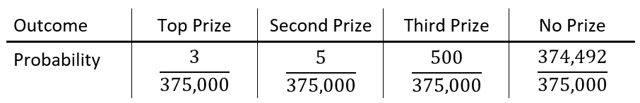
PROBABILITY MODEL
A probability model is a convenient way to describe the distribution of the outcomes of an experiment. It consists of all the possible outcomes of an experiment their corresponding probabilities. It is often useful to display the probability model with a table.
A probability model for the Virginia raffle looks like this.

Slide 29
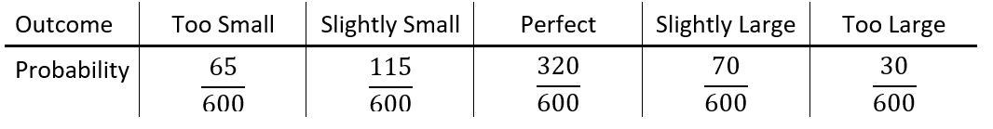
A probability model for the tire size the next custom right receive would look like this.

Slide 30
10
Law of large numbers

Slide 31
LAW OF LARGE NUMBER
The law of large numbers has a very central role in probability and statistics.
It states that if you repeat an experiment independently a large number of times and average the result, what you obtain should be close to the expected value.
There are two main versions of the law of large numbers.
They are called the weak and strong laws of the large numbers.
The difference between them is mostly theoretical.
In this section, we state and prove the weak law of large numbers (WLLN).
The strong law of large numbers is discussed in Section Before discussing the WLLN, let us define the sample mean.

Slide 32
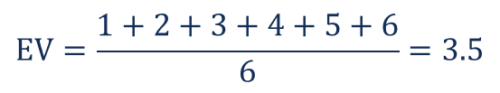
Example of Law of Large Numbers:

Slide 33
11
Central Limit Theorem

Slide 34
CENTRAL LIMITED THEOREM
In probability theory, the central limit theorem (CLT) states that the distribution of sample variable approximates a normal distribution as the sample size becomes larger, assuming that all samples are identical in size, and regardless of the population's actual distribution shape.
The central limit theorem is often used in conjunction with the law of large numbers, which states that the average of the sample means and standard deviation will come closer to equaling the population mean and standard deviation as the sample size grows, which is extremely useful in accurately predicting the characteristics of populations.

Slide 35
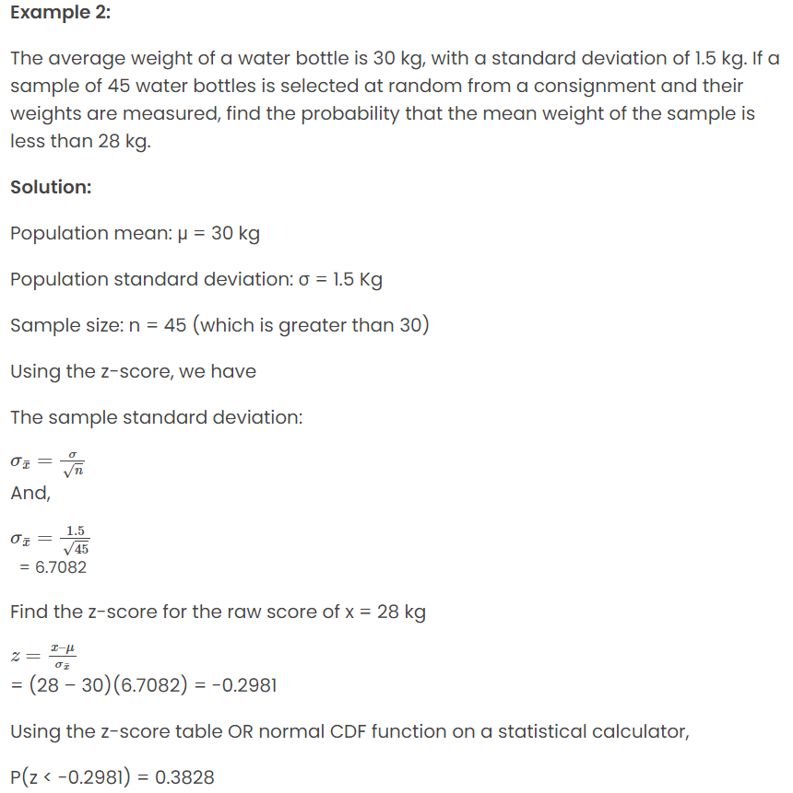

Slide 36
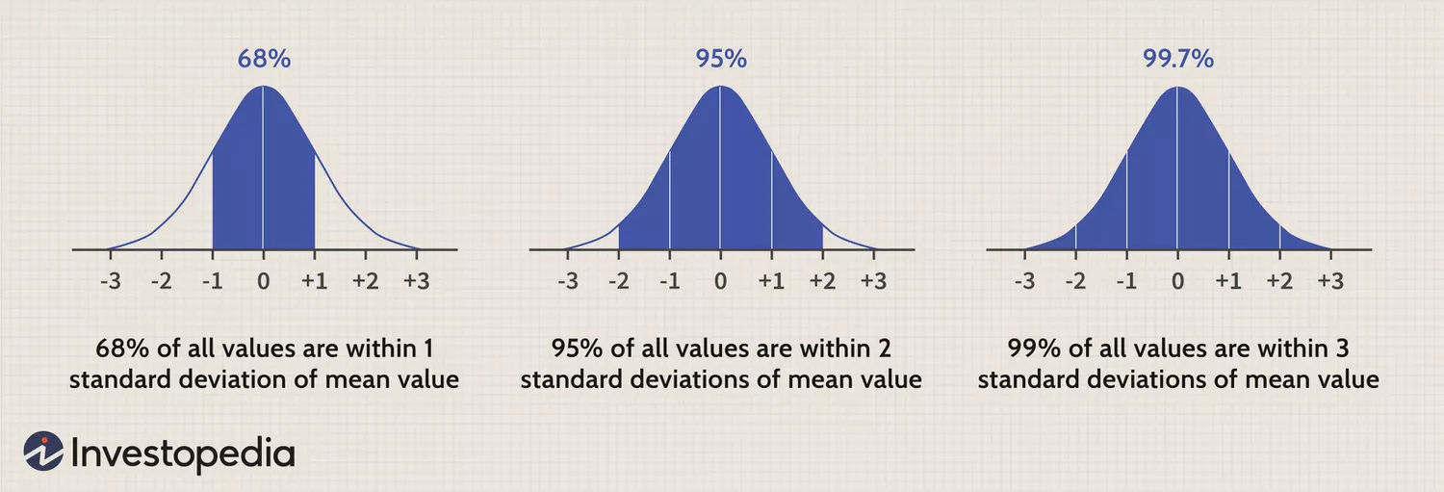
The central limit theorem is often used in conjunction with the law of large numbers, which states that the average of the sample means and standard deviations will come closer to equaling the population mean and standard deviation as the sample size grows, which is extremely useful in accurately
predicting the characteristics of populations.

Slide 37
Thanks!

